Slide 1
OZAS CLINICAL SERVICES
SITE MANAGEMENT & SCIENTIFIC CONSULTING
Clinical research, conducted with editorial precision.
Site Management, Regulatory and Ethics support, and Scientific Writing — for Researcher, Academic Institutions, Hospitals, CROs, and Sponsors.
SITE MANAGEMENT
REGULATORY & ETHICS
TRAINING
MEDICAL WRITING
HTA WRITING

Slide 2
OZAS CLINICAL SERVICES — SITE MANAGEMENT & SCIENTIFIC CONSULTING
ABOUT US
End-to-end clinical research, from feasibility to publication.
We are a specialized site management organization and scientific consulting firm providing quality clinical research solution — tailored for investigator-initiated studies, academic institutions, hospitals, CROs, pharmaceutical companies and public health organizations.
“
To strengthen evidence-based medicine by enabling high-quality, ethical, and impactful clinical research — particularly in academic and public health settings.
”
+ Strong understanding of academic & investigator-initiated research
+ Cost-effective, transparent pricing models
+ Compliance with ICH-GCP, ICMR, CDSCO & IEC guidelines
+ Publication-oriented approach
+ Multidisciplinary expertise — clinical, regulatory, training & writing
OUR VISION

Slide 3
OZAS CLINICAL SERVICES — SITE MANAGEMENT & SCIENTIFIC CONSULTING
CORE SERVICE DOMAINS
Six domains, one continuous research lifecycle.
Clinical Research & Site Management
Regulatory & Ethics Services
Scientific & Medical Writing
CDSCO · DHR · CTRI - NABH
Protocol to Print
Phase II–IV · Registries · IIS
IEC registrations & dossiers
ICF / PIS, incl. translations
SOP development & compliance
Protocols & study reports
Manuscripts & journal support
Abstracts, posters & slides
Site feasibility & start-up
IEC/IRB submissions & review
Monitoring & close-out support
Training & Capacity Building
Systematic Reviews & Meta-Analysis
Health Technology Assessment
Evidence Synthesis
Evidence to Policy
Protocol & PROSPERO support
Screening & data extraction
Meta-analysis & drafting
Clinical & economic review
HTA dossier & report writing
Submission-ready documents
Customized training courses
ICH-GCP training
Training on local country specific regulations
Standard Operating Procedures (SOP) development
Therapeutic area training (Conducted by clinical experts)
Clinical Research Coordinator training

Slide 4
OZAS CLINICAL SERVICES — SITE MANAGEMENT & SCIENTIFIC CONSULTING
WHY CHOOSE OZAS
Built for sponsors who need both rigor and pace.
An academically-minded team that moves at the speed sponsors need, without compromising ethics or data quality.
01
02
03
04
Experienced Clinical Research Professionals
Ethical & Regulatory Compliance
Cost-Effective Solutions
Timely Project Execution
05
06
07
08
Sponsor-Focused Approach
Strong Investigator Network
Patient-Centric Research
Quality-Driven Processes

Slide 5
OZAS CLINICAL SERVICES — SITE MANAGEMENT & SCIENTIFIC CONSULTING
THERAPEUTIC EXPERTISE
Working knowledge across therapeutic areas.
Ophthalmology
Cardiology
Oncology
Neurology
Endocrinology
Dermatology
Orthopedics
Gastroenterology
Infectious Diseases
Medical Devices
WHO WE WORK WITH
Researcher, Academic Institutes, Hospitals, CROs, Investigators & Public Health Programs

Slide 6
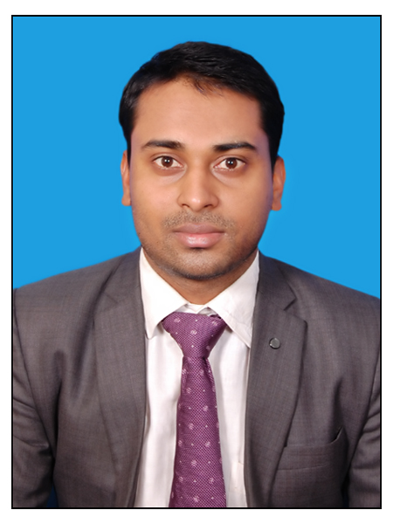
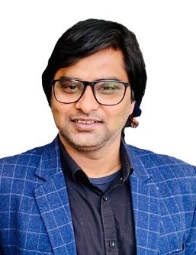
OZAS CLINICAL SERVICES — SITE MANAGEMENT & SCIENTIFIC CONSULTING
LEADERSHIP
Mr. Sachin Gupta
Mr. Gopal Sharma
FOUNDER & DIRECTOR
A clinical research professional leading OZAS's site operations, regulatory strategy and investigator relationships across academic and sponsor-driven studies.
Clinical Trial Operations
Regulatory Affairs
Medical Device Research
Ethics Committee Management
Real-World Evidence Studies

Slide 7




Let's discuss your next study.
Tell us about your trial, registry or manuscript — we'll respond with how OZAS can support it.
OFFICE
70-S, Umerpurniva, Sulem Sarai, Prayagraj. U.P. India
EMAIL
ozasclinicalservices@gmail.com
PHONE
+91-7827898176/8800787803
WORKING HOURS
Monday – Saturday · 9:00 AM – 6:00 PM
OZAS CLINICAL SERVICES ·

